Slide 1

HR Department: Employee Attrition and its Causes

Slide 2
TABLE OF CONTENTS
01
02
03
04
Introduction
Visualization
Statistics
Predictive
Libraries,
Dataset and Data processing
Suggested Plots and EDA
Summary Statistics and Correlation Analysis
Challenges and Opportunities

Slide 3
01
Introduction
Dataset and Data processing

Slide 4




Libraries
Data storage and processing
Visualization and Plotting
Model generation and evaluation
Data transformation and modelling

Slide 5
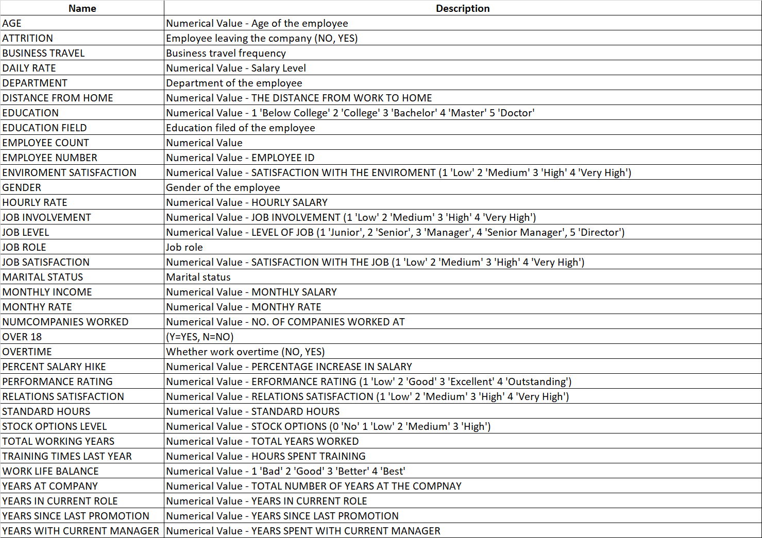

Dataset
Features 1370 HR files with 35 descriptive and categorial variables of individual anonymous employees of a single undisclosed company
Includes metadata for each column in a separate documentation
Is generally well structured, exhibiting no signs of artifacts or inconsistencies
Can be found on kaggle.com together with the original uploaders more ML driven EDA
Workshop-Shopee-machine-learning...

Slide 6
Processing
Validation and processing steps included:
NA Handling: None found
Empty Values: None found
Duplicate Entries, especially UIDs: None found
Elimination of columns with no variance: 3 Variables
Transformation of all categorial variables into descriptive dummies

Slide 7
02
Visualization
Suggested Plots and EDA

Slide 8
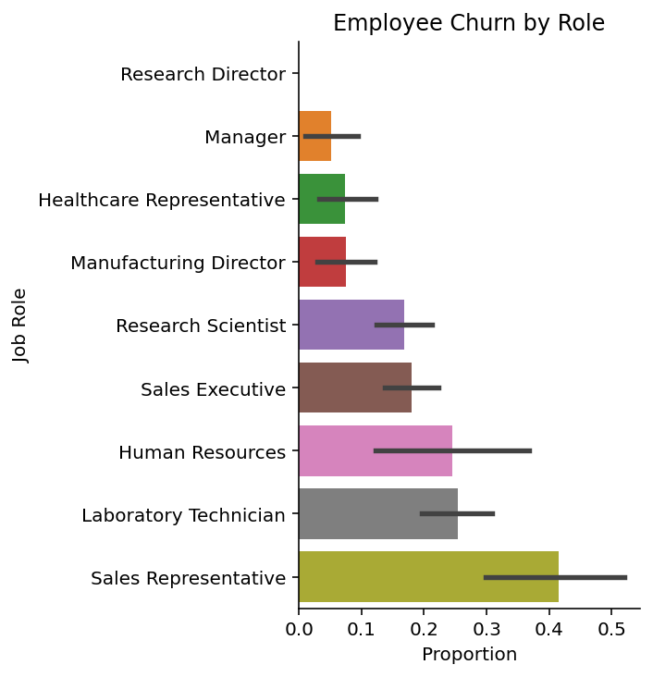
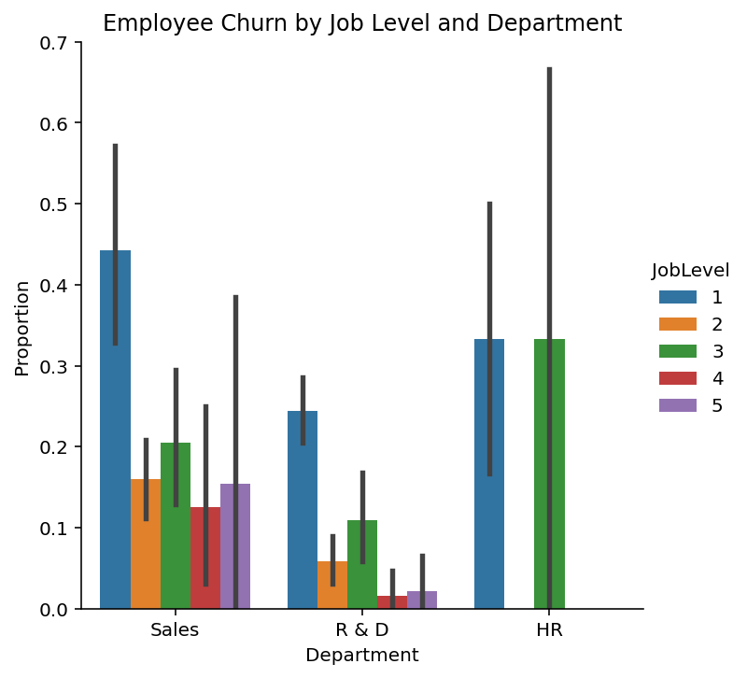
Role and Level
Junior employees have the highest churn rates but outward facing departments generally face increased attrition

Slide 9
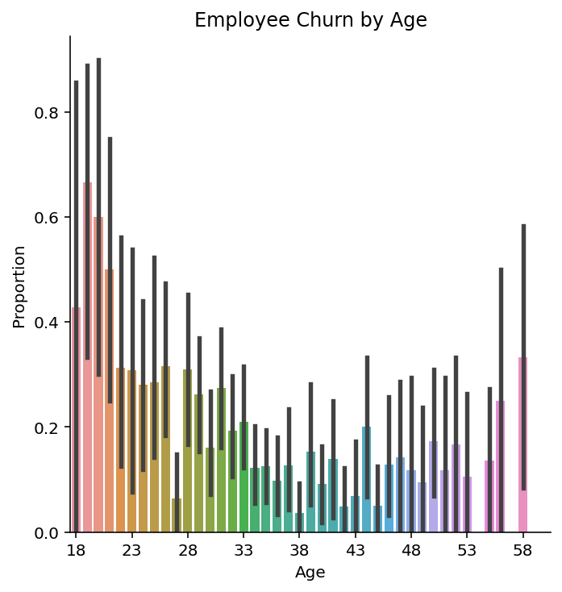
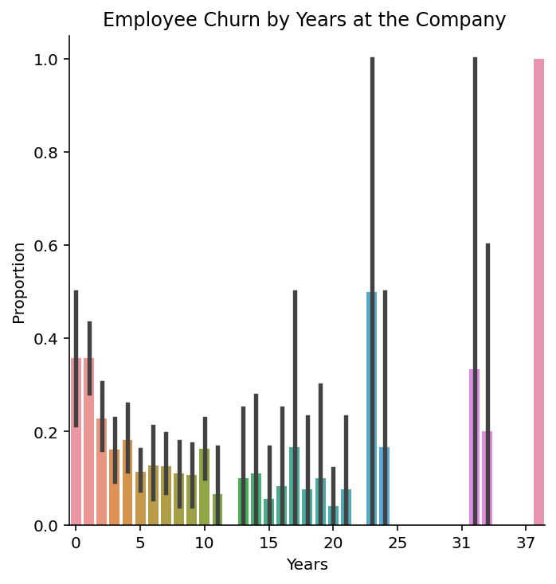
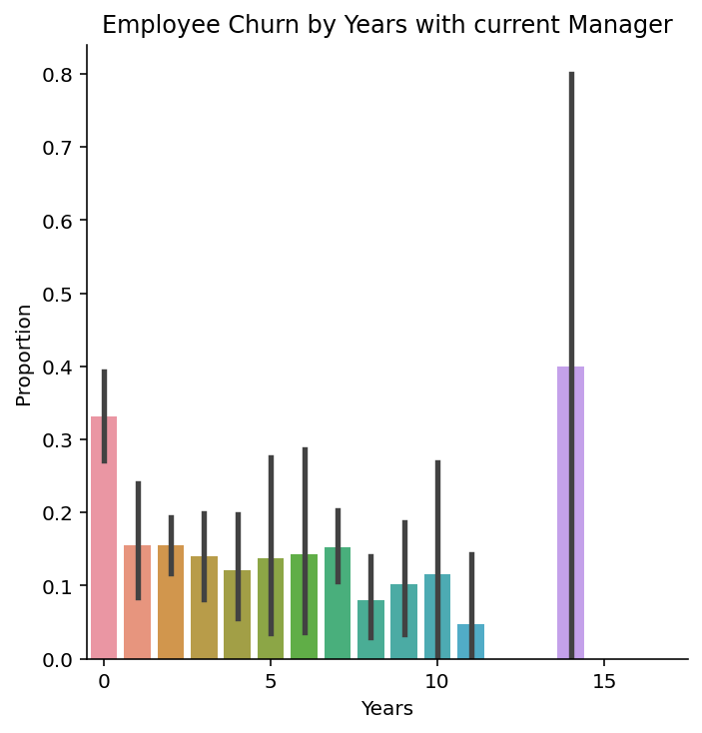
Age and Structures
Plot 1 shows a relative decrease in churn by age until early retirement age
But plot 2 strongly indicates a company pension scheme
Lastly plot 3 highlights the effect of consistent team and management structures to reduce attrition

Slide 10
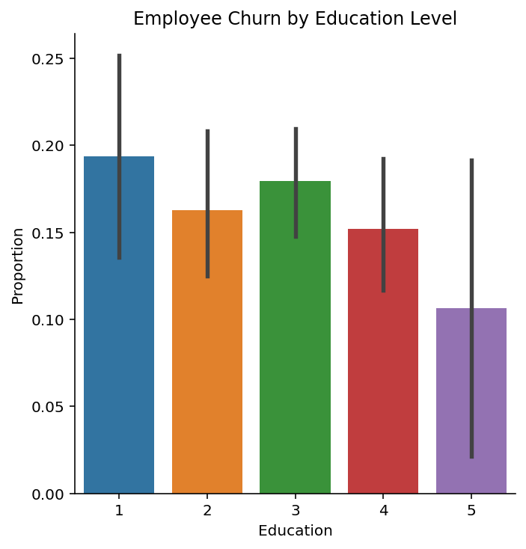
Education
While the churn rate decreases in education level
Our confidence intervals increase as the sample sizes for each additional degree grow smaller

Slide 11
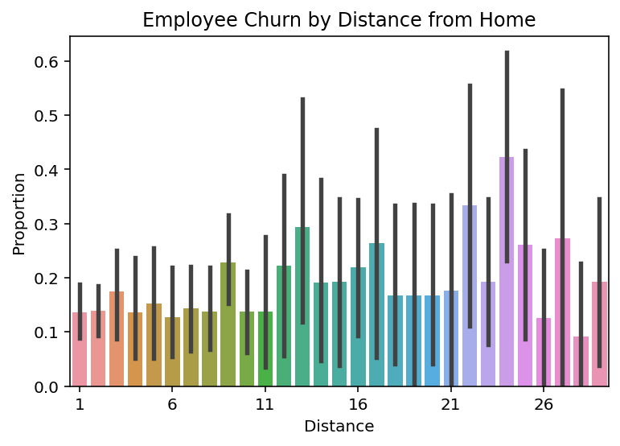
Commute
Churn increases slightly in distance
Regular peaks indicate changes in mode of travel, type of road and geographical features
But variance explodes as sample sizes decrease

Slide 12
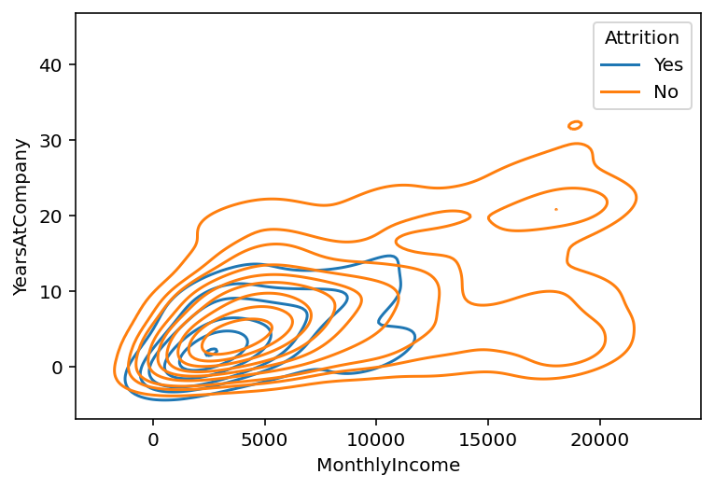
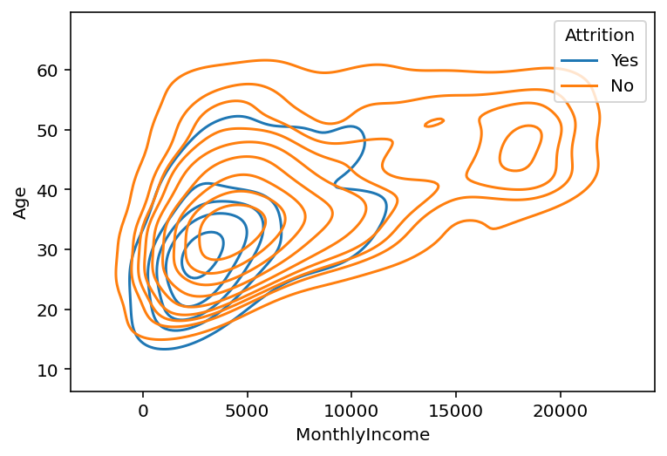
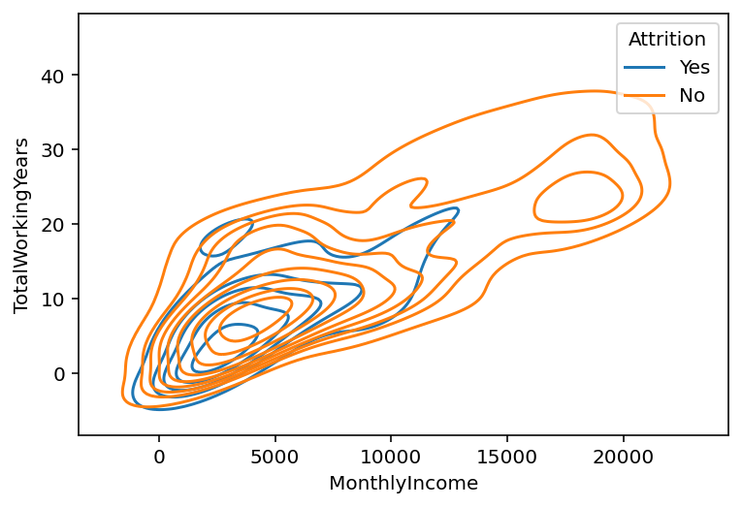
Income
Employees are less likely or willing to churn as age or time at the company increases
But attrition is still far more likely if income is on the lower end of the age~pay scale

Slide 13
03
Statistics
Summary Statistics and Correlation Analysis

Slide 14
Summary Statistics

Slide 15
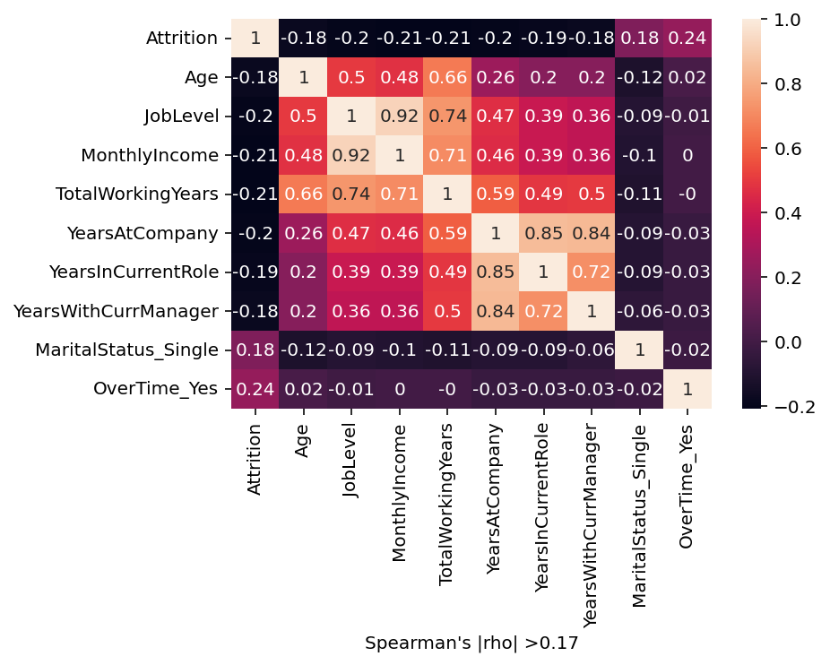
Correlation Analysis
Overtime has the strongest impact
But generally, factors associated with youth and mobility, like unmarried, low job level etc. also noteworthy
However, both soft, like consistency and hard factors, like payment in the top 10 causes

Slide 16
04
Predictive
Challenges and Opportunities

Slide 17
Challenges
High dimensionality hampers intuitive and more hands-on approaches
Endogeneity, cross-interactions and causality likely to cause issues and require additional care in analysis
The dataset is heavily imbalanced with only 16.8% of observations churning
Some more advanced ML algorithms require additional transformation of the data
Part of the data-set needs to be split off to test models to avoid biased in sample predictions

Slide 18
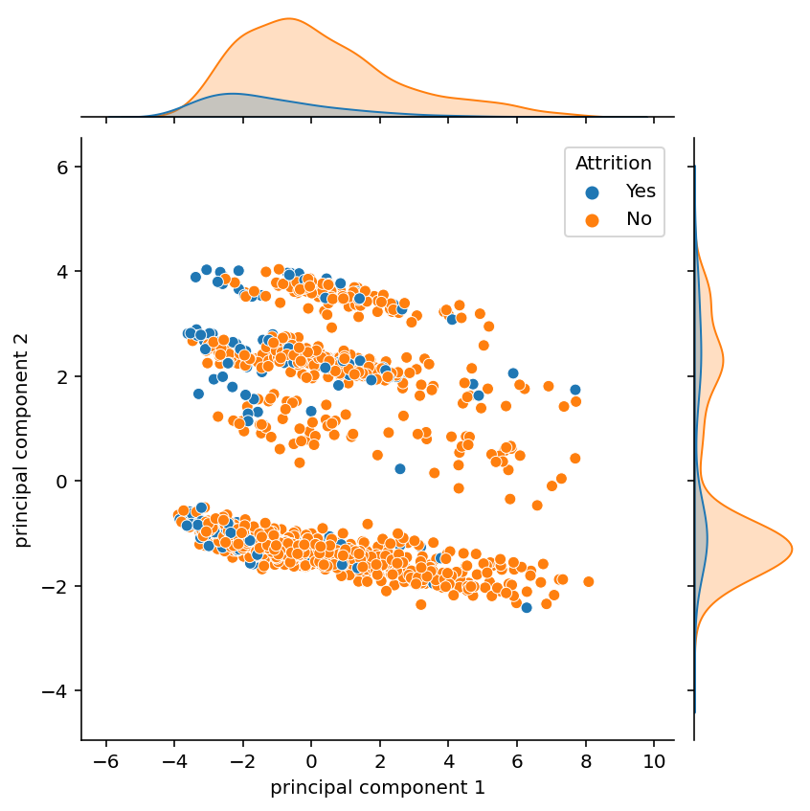
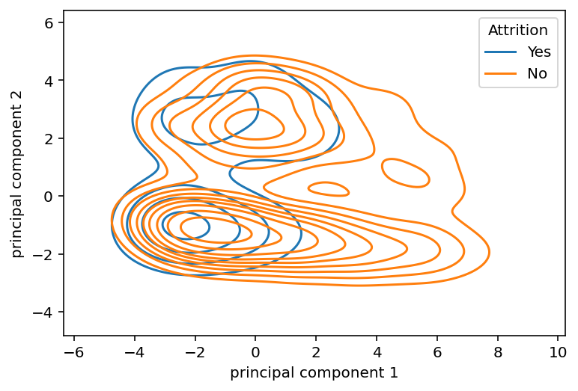
Opportunities
PCA: Enables us to visualize high dimensional data while maintaining a significant share of the original variance

Slide 19
Opportunities
Linear probabilities enable intuitive interpretation and explanation
But consistent variance estimation is not possible
P-value driven exploration is therefore of doubtful benefit
Can however still perform well if benchmarked

Slide 20
THANK YOU

